Slide 1
Looking Ahead…
Final Exam – semi-cumulative (50%)
50 ID’s
2/3 of IDs = lab 7&8
1/3 = Cumulative (labs 1-6)
75 Short answer, MC, T/F questions
50% cumulative
Sakai Final exam resources
Study guide
Review opportunities
Review session
Open labs
Notes:
**extra sample questions beyond what is on the study guide during Review Session

Slide 2
Anatomy Lab #7 Part I: Anatomy of the Heart and Circulation
Objectives for this lab:
Identify the structures of the heart and its vessels
Know the path of blood flow into and out of the heart’s four chambers
Identify the major arteries leaving the aorta in the thorax

Slide 3
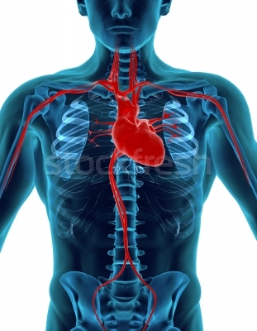
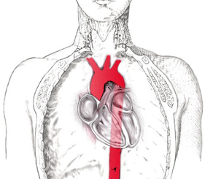
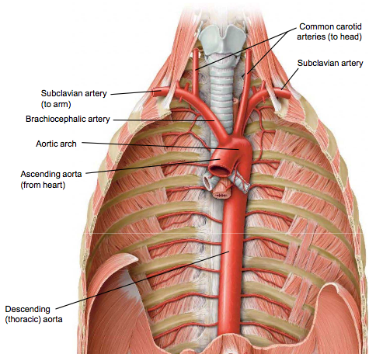
Asymmetry
Heart leans LEFT
-> LEFT lung has 2 lobes
Aorta turns LEFT
-> RIGHT brachiocephalic artery ‘makes up’ for asymmetry

Slide 4
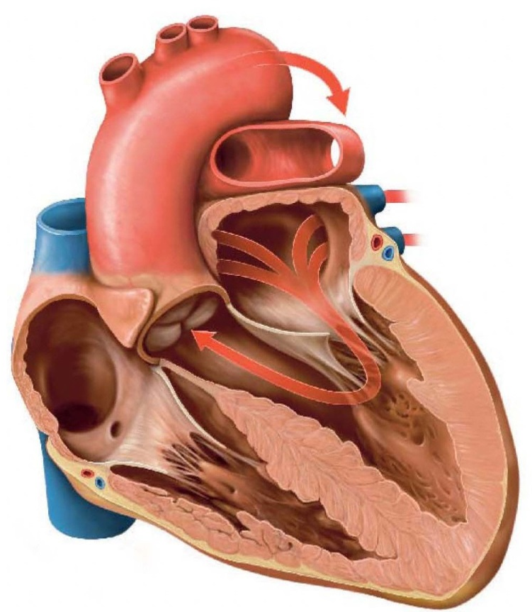
Helpful Hints and Mnemonics
Tricuspid vs. Bicuspid:
LAB RAT
LEFT – Bicuspid
RIGHT = Tricuspid
TRY before you BUY
Order of blood flow
LEFT Ventricle myocardium = BIGGER
Why??
ARTERIES -> AWAY FROM HEART

Slide 5
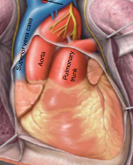
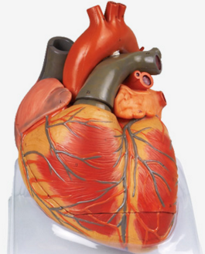
Helpful Hints and Tips
Colors on heart figures and models don’t always line up
On figures:
Red = artery (away from heart)
Blue = vein (to heart)
On models:
Red = oxygen-rich
Blue = oxygen-poor

Slide 6
Understand The Words
Brachio-cephalic
Goes to arm and head
Subclavian
Below clavicle
-Cardia
Myo, Endo, Epi
Valves
Atrioventricular – where is it?

Slide 7
Valves
Atrioventricular (b/w Atrium & Ventricle)
Tricuspid
Mitral (bicuspid)

Slide 8
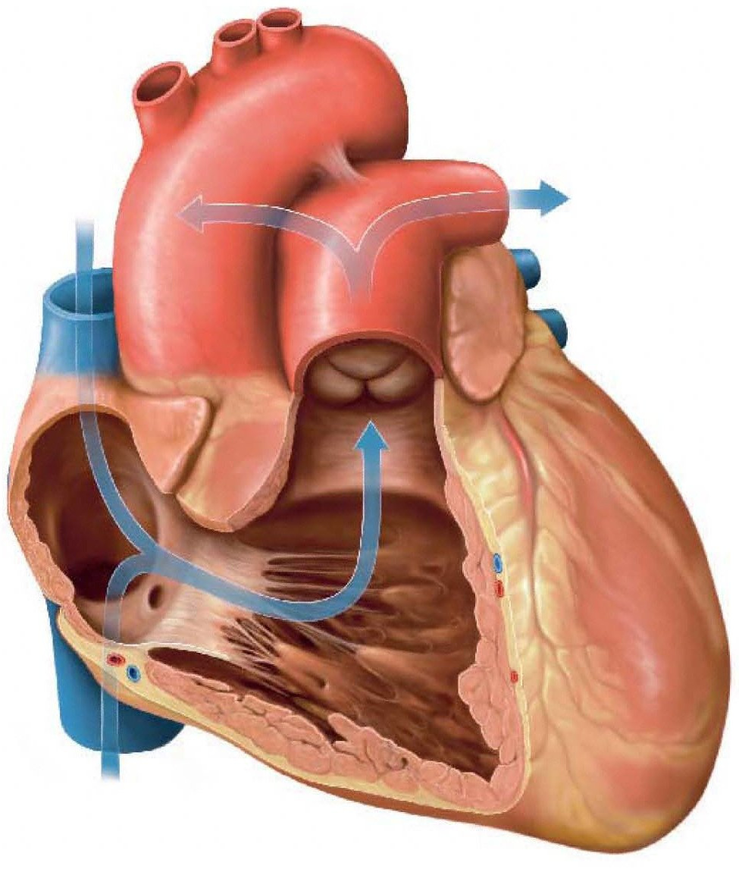
Circulation through the heart’s right side:
Superior and Inferior Vena Cavae
Right Atrium
Tricuspid valve
Right Ventricle
Pulmonary Semilunar Valve
Pulmonary Trunk
Pulmonary Arteries
From upper body
To lungs
Pulmonary
Semilunar
Valve
Right atrium
Right AV/
Tricuspid Valve
From lower body
Right ventricle

Slide 9

Circulation through the heart’s left side:
Lungs
Pulmonary Veins
Left Atrium
Bicuspid Valve
Left Ventricle
Aortic Semilunar Valve
Aorta
To body
Aortic
Semilunar
Valve
Left
atrium
From lungs
From lungs
Left AV/
Bicuspid
Valve
Left
ventricle

Slide 10

How about a video
Source: OSFCPhysEd

Slide 11
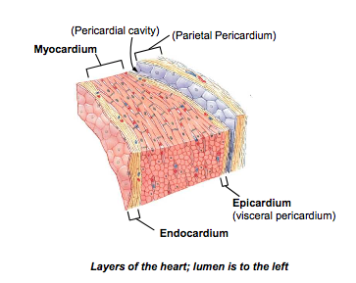
Layers of the Heart
Myocardium is the muscular layer of the heart
Note that the myocardium of the left ventricle is thicker than the right ventricle
Why do you think this is?

Slide 12
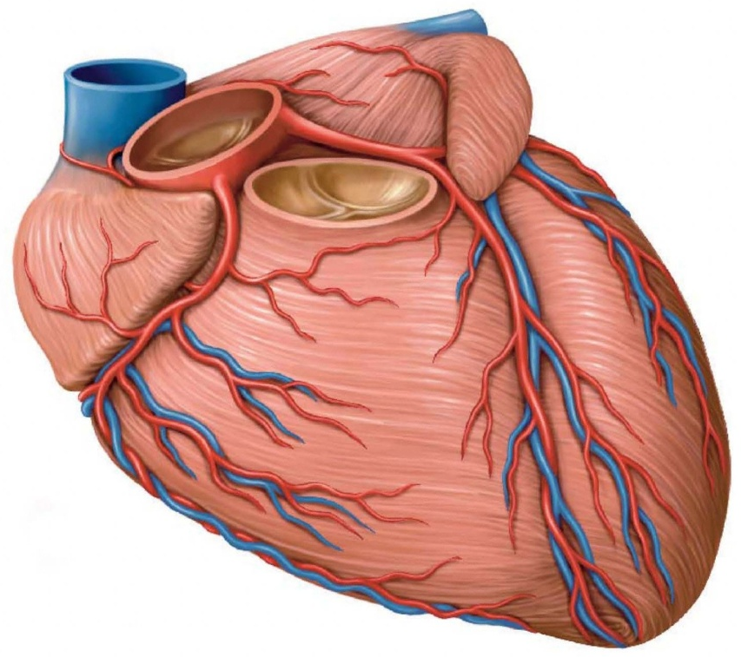
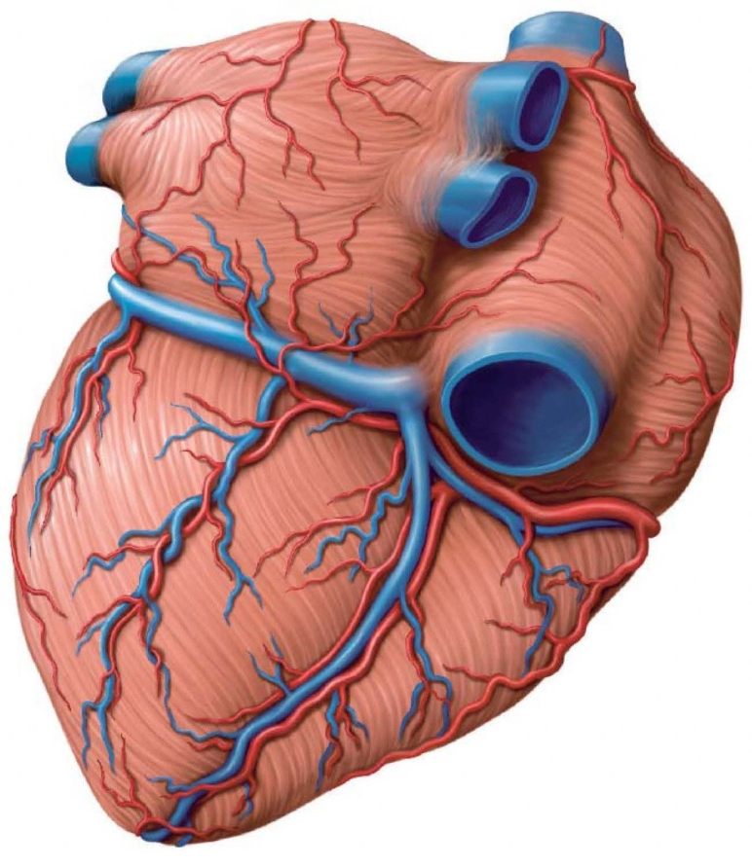
Blood Supply to the Heart
Aorta
Coronary arteries
Cardiac veins
Coronary Sinus
Right Atrium
Aorta
Left
atrium
Left coronary artery
Left
atrium
Right
atrium
Coronary sinus
Right
atrium
Right
coronary artery
Left
ventricle
Right ventricle
Left
ventricle
Right ventricle
Anterior view
Posterior view

Slide 13
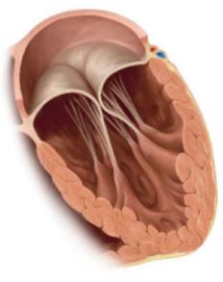
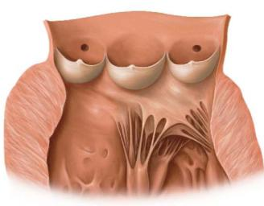
Heart Valves
Chordae Tendinae
Atrioventricular valves allow blood to flow from atria to ventricles
Semilunar valves allow blood to flow from ventricles to aorta or pulmonary trunk
Blood can only move in one direction
Blood moves because of pressure differences
Papillary Muscles
Right AV Valve
Aortic Semilunar Valve Cut Open

Slide 14
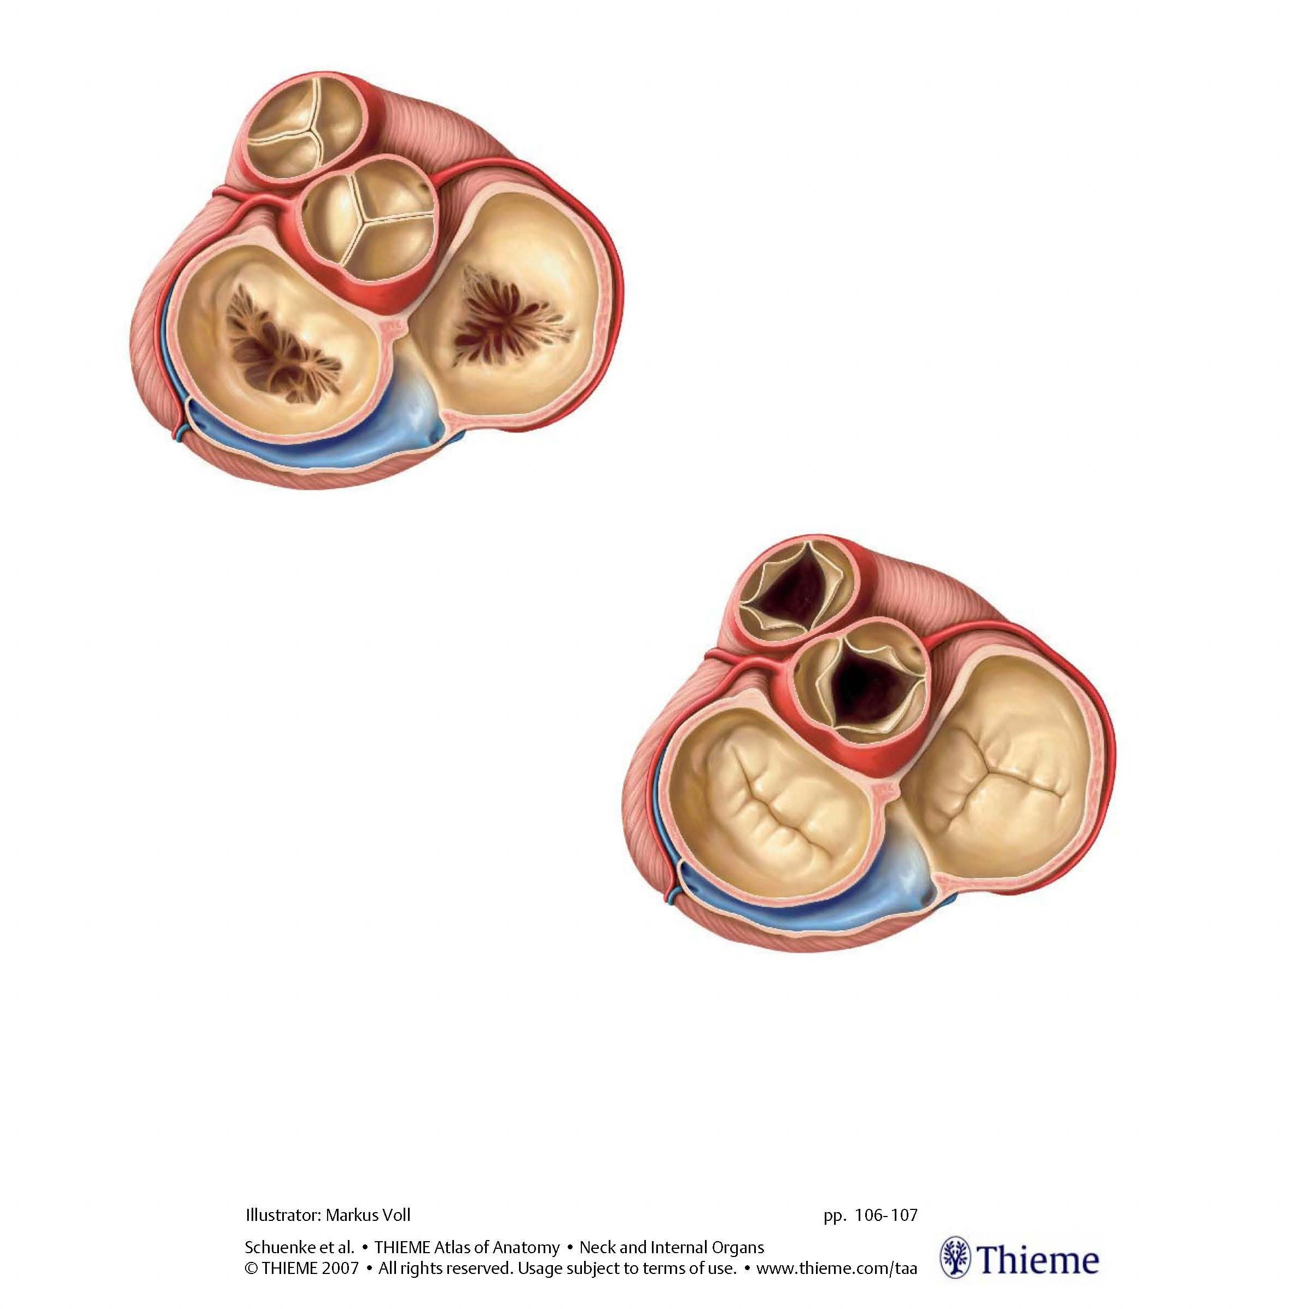
Heart Valves: View from Above
When the ventricles are resting…
AV valves are open, allowing blood to enter the ventricles from the atria
Semilunar valves are closed, preventing blood in aorta and pulmonary trunk from moving back into the ventricles

Slide 15
Heart Valves: View from Above
When the ventricles are contracting…
Semilunar valves are open, allowing blood to flow out into the aorta or pulmonary trunk
AV valves are closed, preventing blood in ventricles from moving back into the atria

Slide 16
Major Arteries
Aorta has 3 major branches:
Brachiocephalic Artery
Left Common Carotid Artery
Left Subclavian Artery
It then becomes the descending aorta
After passing through the diaphragm, it is the abdominal aorta
Anatomy Tip: Arteries take blood Away from the heart

Slide 17
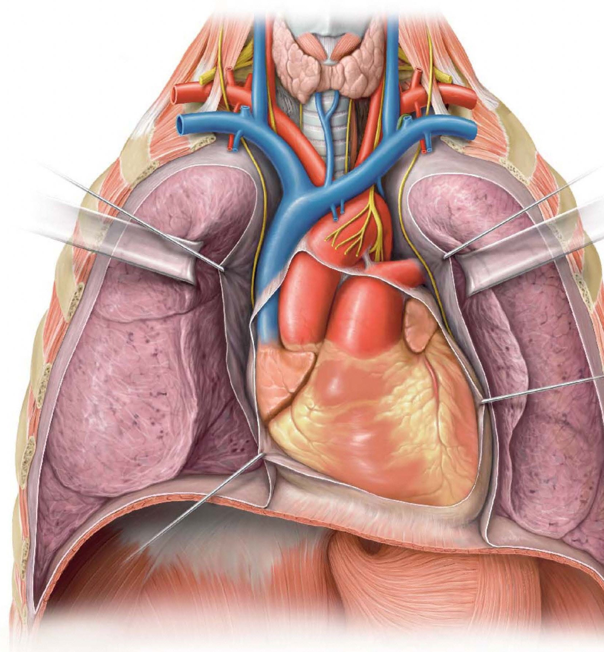
Major Veins
Internal jugular veins (from brain)
Subclavian vein
(from arm)
Subclavian vein
(from arm)
Brachiocephalic veins
Subclavian and Internal Jugular veins combine to form each Brachiocephalic vein
Left and Right Brachiocephalic veins combine to form the Superior Vena Cava
Superior vena cava
Aorta
Pulmonary trunk

Slide 18
Anatomy Lab #7 Part II: The Respiratory System
Objectives for this lab:
Understand the structures involved in the passage of air from the external nares to the lungs
Identify and distinguish between primary, secondary, and tertiary bronchi
Know the structure of the larynx and how sound is produced
Understand the arrangement of pleural membranes and the pleural cavities

Slide 19
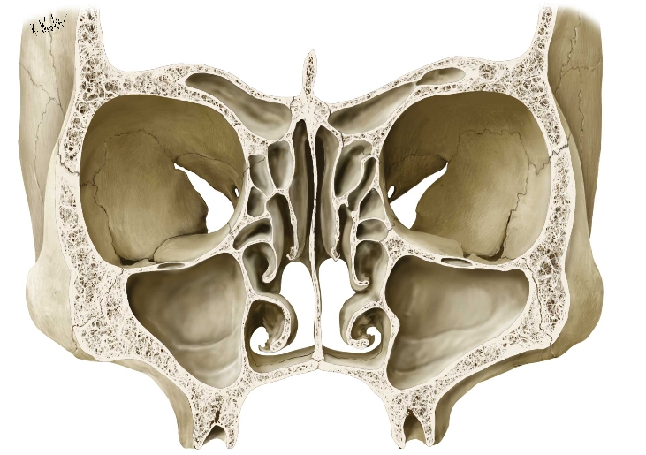
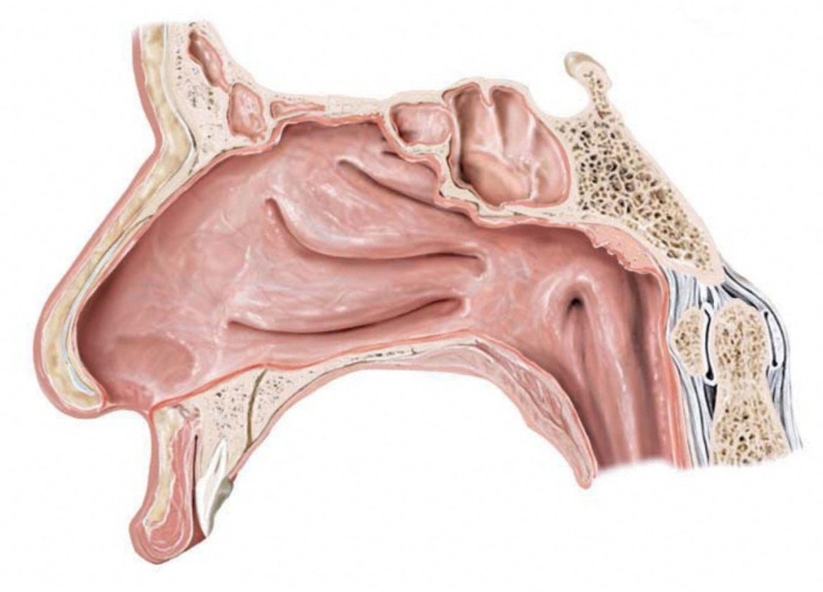
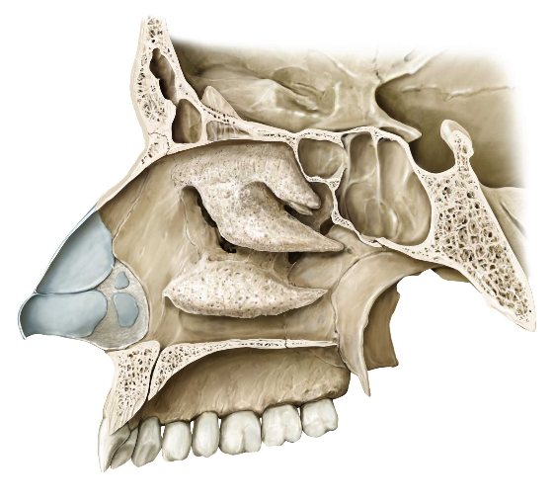
The Nasal Cavity
Divided by nasal septum
Nasal conchae
Paranasal sinuses
Hard and soft palate
Paranasal sinuses
Superior conchae
Middle conchae
Inferior conchae
Nasopharynx
Hard palate
Soft palate

Slide 20
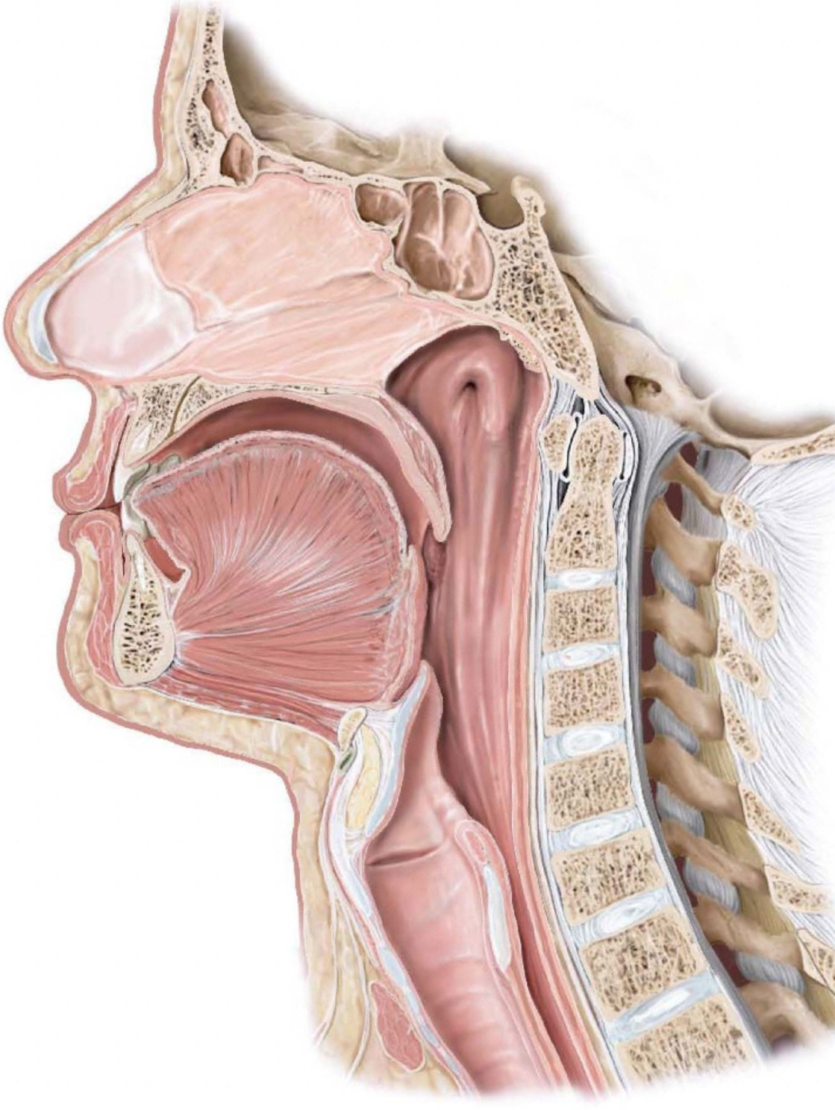
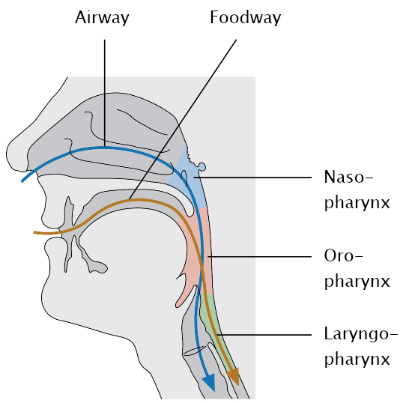
The Divisions of the Pharynx
Nasal septum
Oral cavity
Naso-
Oro-
Laryngo-
Larynx
Esophagus
Trachea

Slide 21
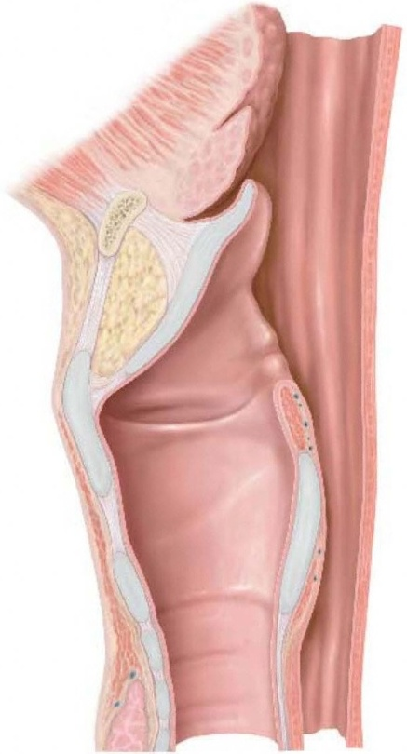
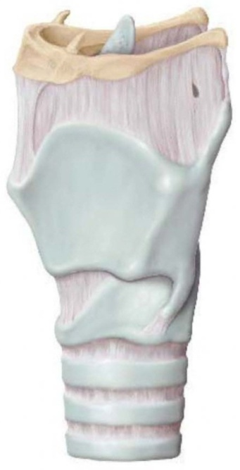
The Laryngeal Cartilages
Thyroid cartilage
“Adam’s Apple”
Prominent on anterior surface
Cricoid cartilage
Most inferior
Prominent on posterior surface
Epiglottis
hyoid
epiglottis
Thyroid cartilage
Cricoid
cartilage
← anterior posterior →

Slide 22
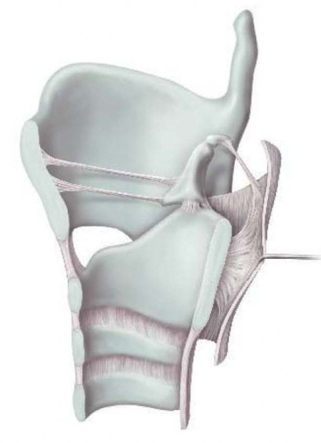
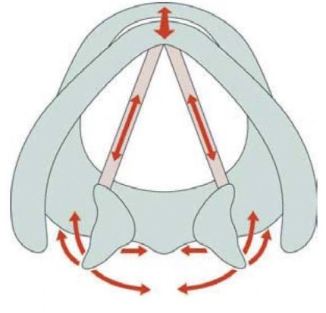
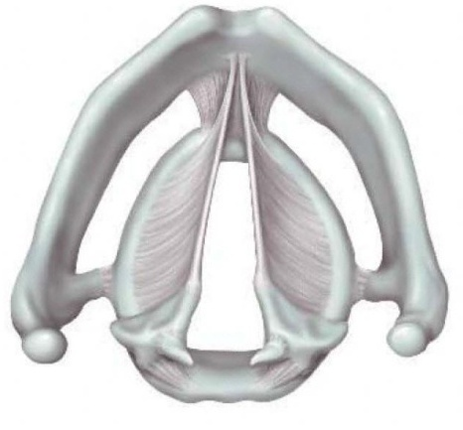
Sound Production
Vocal folds
Mucosal lining covering vocal ligaments
Positioned by arytenoid cartilages
Glottis
Small hole through which air is expelled
Sound produced by vibration of vocal folds
Vocal fold
Arytenoid cartilage
Thyroid cart.
Thyroid
cartilage
Vocal ligaments (covered by vocal folds in life)
Cricoid cart.
Arytenoid cartilages
Glottis
Superior view

Slide 23

How about a video
Sources: 1, 2, 3

Slide 24
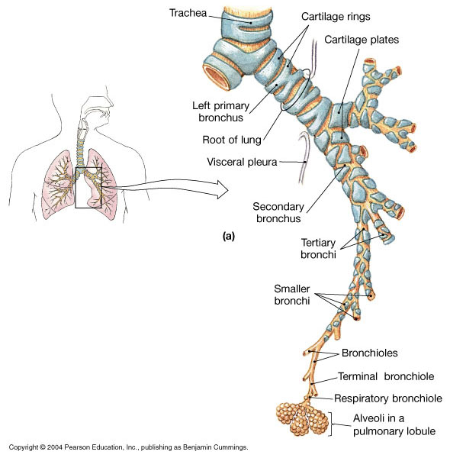
The Bronchial Tree
Primary Bronchus
Secondary Bronchus
Tertiary Bronchus

Slide 25
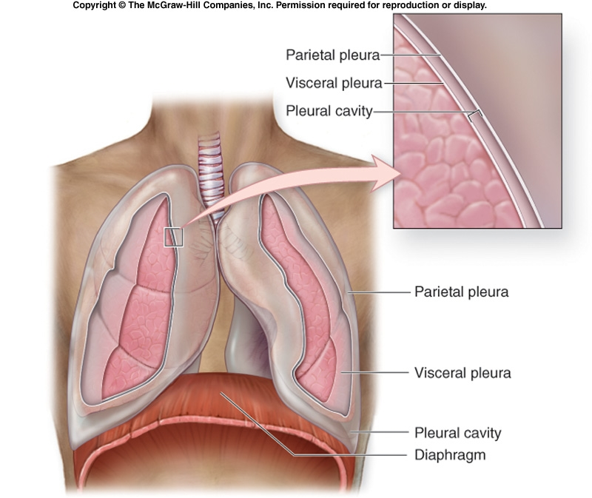
Pleural Membranes
Visceral Pleura
Pleural Cavity
Parietal Pleura

Slide 26
Things you can’t see
Endocardium
Epicardium
Parietal pleura
Visceral pleura
Pleural cavity

