Slide 1
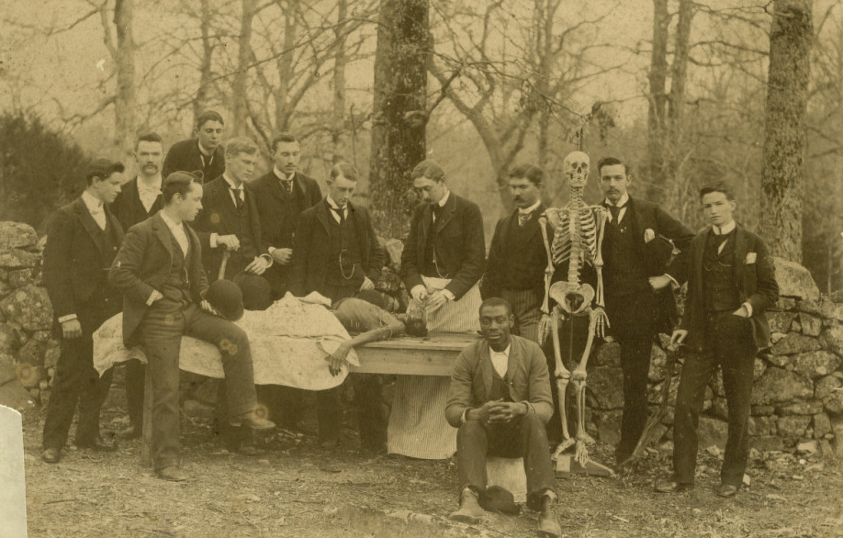
BIOLOGY 252 ANATOMY & PHYSIOLOGY LAB
UNC Anatomy class, 1890
North Carolina Collection Photographic Archives

Slide 2
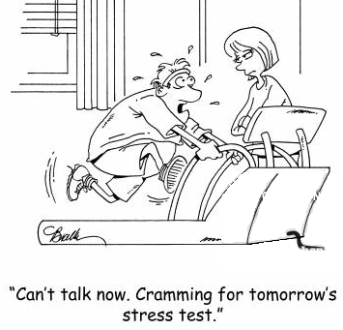
Tips
Expectations
Yes it’s 1 credit hour, but PLAN to put in a lot of time to do well
Just the “nature of the beast” -> A lot to cover in a little time!
Work SMARTER not HARDER
I’ll give you tips….
Study
OFTEN
Do not cram for exams – you will fail!
Review each night (even a tiny bit)
Mix it up
Lab manual, review materials online, pictures
Mnemonics, songs, USE YOUR OWN BODY
Study Aids
Spend (FULL) time wisely in LAB!!

Slide 3
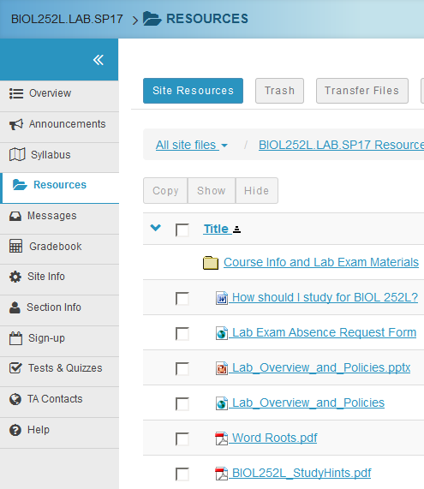
Tips
Always bring COLOR copy of Lab manual
Work in pairs/ groups
Move around
Always Orient Yourself!
Consider:
Etymology / word meaning
Relative location
Function
Relation to other body systems
Many resources!!
TA (Chris) + Lab Apprentice
Lab manual + Other Sakai Resources
Internet (Youtube, Wikipedia)
All models!!

Slide 4
Tips
Always bring COLOR copy of Lab manual
Work in pairs/ groups
Move around
Always Orient Yourself!
Consider:
Etymology / word meaning
Relative location
Function
Relation to other body systems
Many resources!!
TA (Chris) + Lab Apprentice
Lab manual + Other Sakai Resources
Internet (Youtube, Wikipedia)
All models!!
#1 Tip!
Approach this lab CONCEPTUALLY
Do NOT attempt to simply MEMORIZE everything!
_____________________
Yes, a ton of memorization is important, but do so SMARTLY

Slide 5
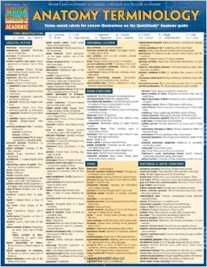
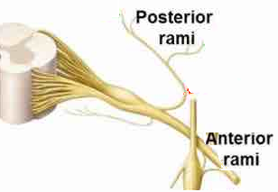
Example
HELP!!
Do not memorize large lists of words without understanding them
1 Helpful Approach:
Think about anatomy as building phrases
Learn word meanings
Apply “adjectives”
Cuts back on # of new words to learn!
Ramus
Etymology:
“branch”
Definition:
division of a spinal nerve
Applications:
Posterior ramus (branch to the back)
Anterior ramus (branch to the front)
Notes:
More work up front, but LESS time studying later, and you’ll get a better grasp of the material.
You’ll remember it longer cause you understand concepts!!

Slide 6
Intro: Anatomical positions
(Dorsal)
(Ventral)
Notes:
Purpose: to all speak the same language (anatomical language)!

Slide 7
How about those guided reading questions (GRQ’s on Connect)?!
Not “Homework”, but a tool. These are to PREPARE YOU for lab!
Questions ≠ simple identification, but challenge you to understand what you’re reading
They are open-book (manual). Actually read, don’t just hunt for answers. It’ll be easier in the long run
Help you prepare + Easy points!! ☺

Slide 8
Announcements
Any technical problems with self-study or GRQs should be direct to Dr. Johnson: johnsonc@bio.unc.edu
Next week’s GRQs should be competed after reading Chapter 2 of your manual. It must be completed before the start of lab.
Peer mentoring available Thursdays 3-6 & Fridays 9-12 in W111
No appointment needed; walk in anytime
Get help or review models from current or past labs

Slide 9
Anatomy Lab #1: Spinal Cord & Spinal Nerves
Objectives for this lab:
Gross + cross-sectional anatomy of spinal cord
Anatomical components of the spinal cord + nerves that participate in the autonomic nervous system
Understand the spinal cord’s functional components
Be able to describe the functional components that make up spinal nerves, roots, and rami
Understand dermatomes
Understand spinal reflexes
Notes:
Go through objectives.
Place focus on structure identification and function.

Slide 10
Anatomy

Slide 11
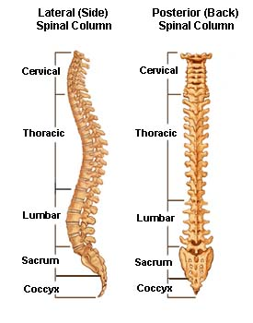
Quick intro: Vertebrae
7
12
5
5
3-5
Meals of the Day
7 Cervical
12 Thoracic
5 Lumbar
Fused Vertebrae
5 Sacral
3-5 Coccygeal

Slide 12
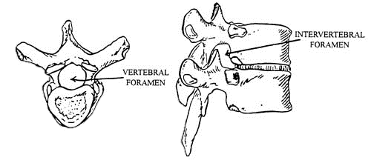
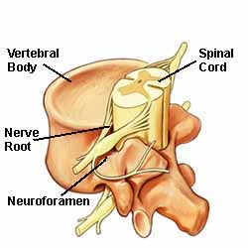
Quick intro: Terminology
Foramen = a hole
vertebral (through vertebrae, big)
intervertebral (b/w vertebrae, little )
Vertebral Canal

Slide 13
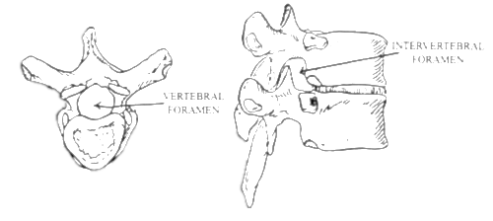
Quick intro: Terminology
Foramen = a hole
vertebral (through vertebrae, big)
intervertebral (b/w vertebrae, little )
Vertebral Canal
Process = a bony projection
Spinous process (feel on your own back!)
Which side of the body is the VERTEBRAL BODY on?

Slide 14
Gross Anatomy of the Spinal Cord:
Location: in vertebral canal
Extent: from 1st cervical vertebra to 2nd lumbar vertebra
Function: to bring information...
to the body from the brain (to control muscles)
from the body to the brain (to inform brain of surroundings)

Slide 15
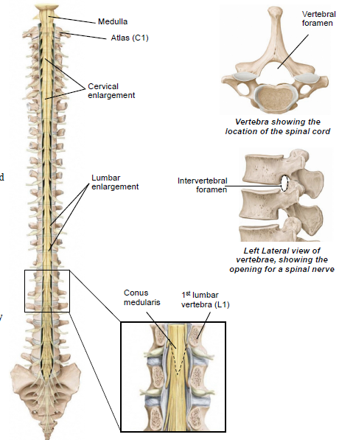
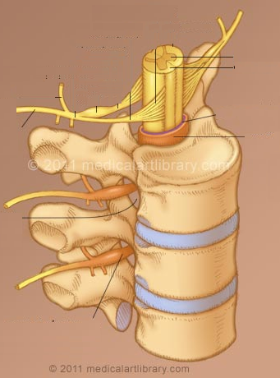
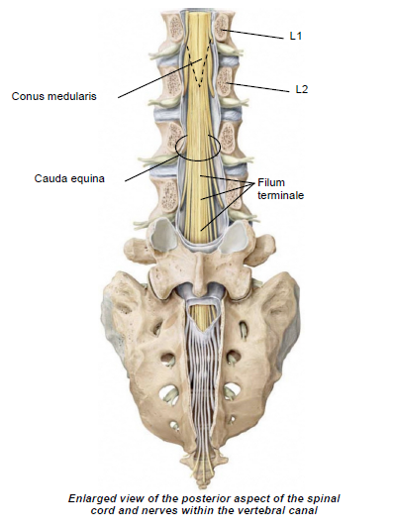
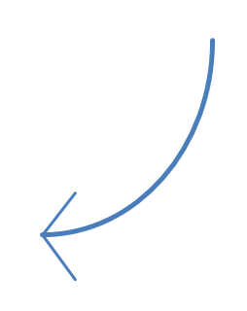
Gross features:
Cervical and lumbar enlargements
Conus medullaris
Filum Terminale
Spinal nerves
Cauda equina
(C3 -> T2)
What’s their significance?
(T11 -> Conus Medullaris)

Slide 16
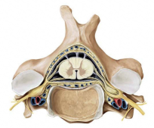
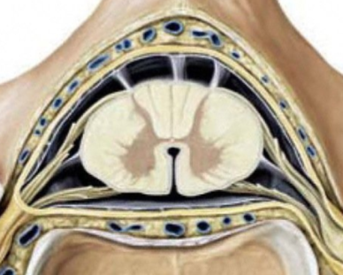
The Vertebral Canal
Spaces
Epidural space: filled with fat and blood vessels
Subarachnoid space: filled with cerebrospinal fluid (CSF)
Meninges (protective layers)
Dura mater
Arachnoid mater
Pia mater
Spinal cord
White matter
Gray matter
Central canal (contains CSF)
Epidural space
Dura mater
Arachnoid mater
Subarachnoid space
Denticulate ligament
Pia mater
Cross section of spinal cord at C4

Slide 17
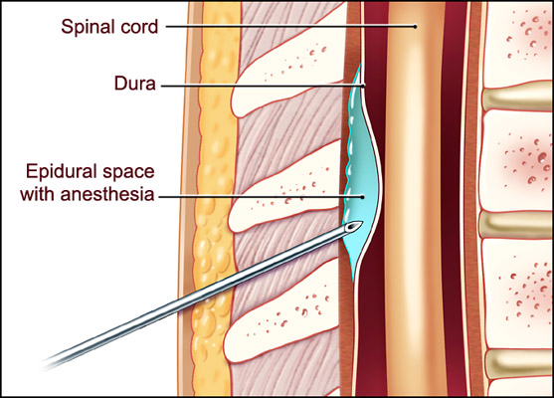
Labor pains? Get an epidural!
https://www.youtube.com/watch?v=rM1aQC-HAX0
Notes:
Ask students to point out different parts of the spinal cord in video.
Here we are going to take a look at an epidural. So who wants to tell me what an epidural shot is most commonly used for? Right, labor pains. In this video, we get to take an inside look on how an epidural shot is done. Try to figure out what and where the structures we just talked about are.

Slide 18
Identification Mini-quiz part 1
Get in groups of 3-4
Use whiteboard to write down the answers
This is not graded.
You may use your groupmates, but try not to consult your lab manual.

Slide 19
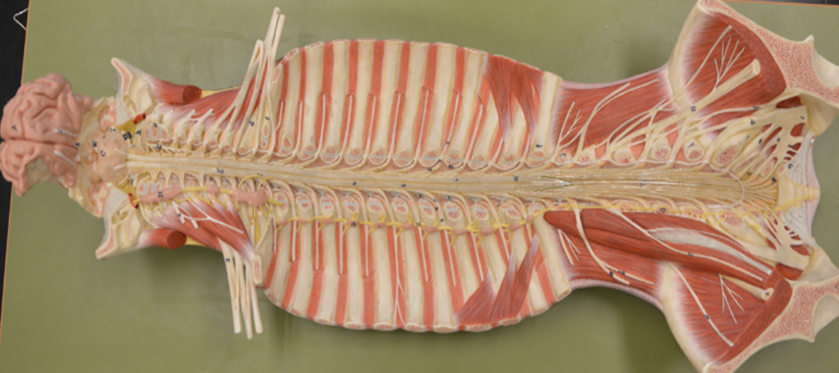
Identification Mini-Quiz part 1.a
1
BE AS SPECIFIC AS POSSIBLE
2
3
4
5
Notes:
1. Cervical Enlargement
2. Lumbar Enlargement
3. Conus Medularis
4. Filum Terminale
5. Lumbosacral Plexus

Slide 20
Function

Slide 21
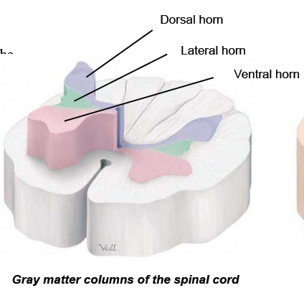
Gray Matter of the Spinal Cord
3 Major Horns
Type of information
Dorsal
Sensory (both visceral AND somatic)
Ventral
Somatic motor
Lateral
Visceral motor
Note:
Somatic = relating to body
Visceral = relating to organs
Notes:
Explain what kind of information horn hold. Where does each horn lead the information to/from?

Slide 22
Dorsal, Ventral, huh?
Dorsal
Think dorsal fin!
Exposed to the sensory elements → Sensory!!
Ventral
Think of a baby crawling around on belly
“motoring around” → Motor!!
Notes:
This is just a mnemonic. You are more than welcome to add your own.

Slide 23
Spinal Nerve Roots
A spinal nerve is a mixed nerve containing motor and sensory neurons
It has two roots that are unmixed
The dorsal root contains sensory neurons
The ventral root contains motor neurons

Slide 24
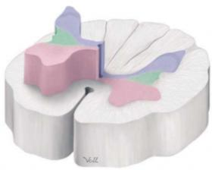
Functional Anatomy of the Spinal Cord
Sensory information arrives at the dorsal horn of the gray matter
To inform the brain, information must travel along another neuron within the white matter
up to brain
Dorsal (posterior) horn

Slide 25
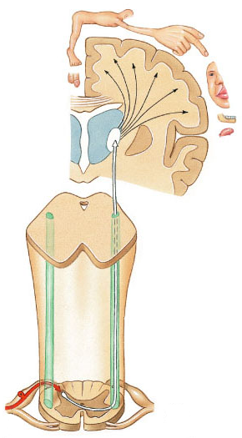
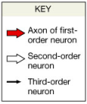
Ascending Pathways
Distribution of the somatosensory cortex
Ascending pathways send sensory information to the brain
1st order neuron is peripheral (sensory)
2nd order neuron brings stimulus information up the spinal cord (white matter) to the thalamus
3rd order neuron from the thalamus sends info to the somatosensory cortex (post central gyrus)
Why is it called “spinothalamic tract” ?
Synapse in thalamus
Medulla
Synapse in dorsal horn
Spinal cord
Spinothalamic tract (white matter)
periphery
Sensory information from right side of body
Decussation

Slide 26
Functional Anatomy of the Spinal Cord
Commands from the brain travel down to the appropriate spinal level
Motor information arrives at the ventral horn of the gray matter and motor neurons are stimulated
down from the brain
Ventral (anterior) horn

Slide 27
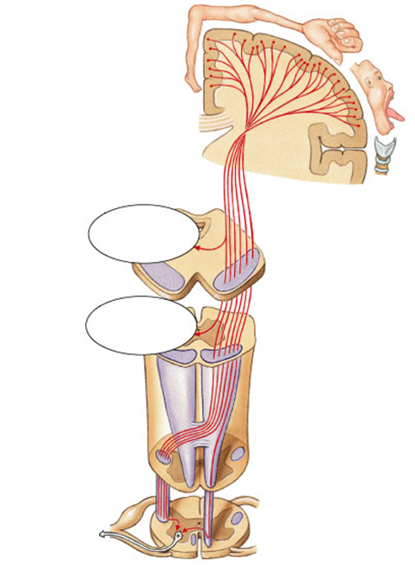
Descending Pathways
Command issued to move arm muscle
Descending pathways send instructions to the muscles
1st neuron originates in the primary motor cortex (precentral gyrus) and travels to ventral horn of spinal cord
2nd neuron (motor neuron) brings instructions to muscles
Why is it called “corticospinal tract”?
To head muscles
To neck muscles
Corticospinal tract
Synapse in ventral horn
Decussation
To arm muscle

Slide 28
What’s the difference between the two tracts?
Spinothalamic tract
Ascending pathway
3 neurons
Remember: Since it hasn’t reached the brain, it is NOT “smart” and needs 3 neurons to complete the task!
Corticospinal tract
Descending pathway
2 neurons
Remember: Since it’s coming from the brain, it is “smart” and only needs 2 neurons to complete the task!
Notes:
This is a summary of the two tracts.

Slide 29
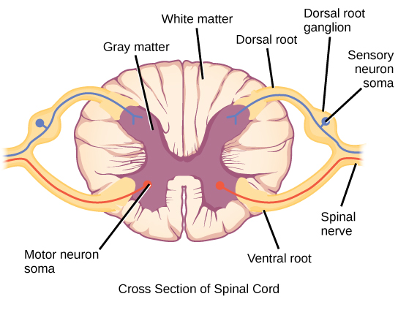
Where next?
So we know:
Spinal cord sends signals up/down via tracts
Spinothalamic
Corticospinal
Brain processes info in functional cortices (sing = cortex)
Somatosensory
Primary Motor
Other structures of the brain = important
Thalamus
Medulla
Horns bring/send info to/from spinal cord
Located within spinal cord
Roots bring/send info to/from spinal cord
Located external to spinal cord
Spinal Nerve!
Splits….

Slide 30
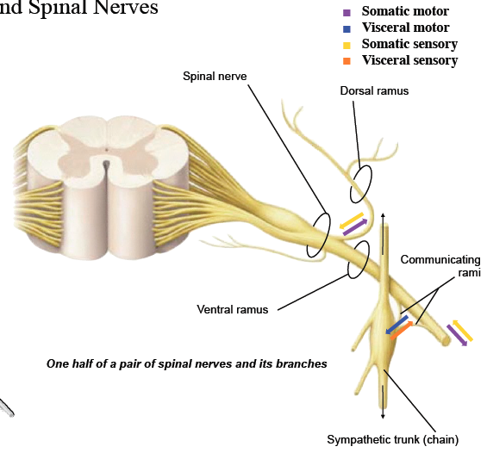
Rami Connect the Spinal Cord to the Body
Where does the information come/go?
Ventral
Ventral / lateral sides of body
Limbs
Dorsal
Dorsal side of body
Communicating
Viscera (aka organs)

Slide 31
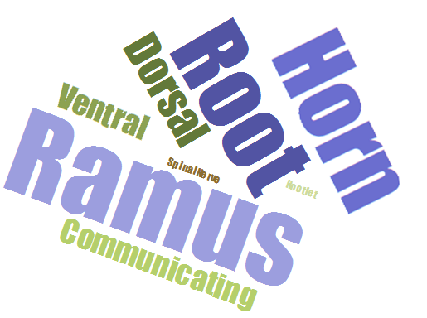
SO MANY WORDS!!
I’m bound to get them all confused!
If only there was some way to remember their order…

Slide 32
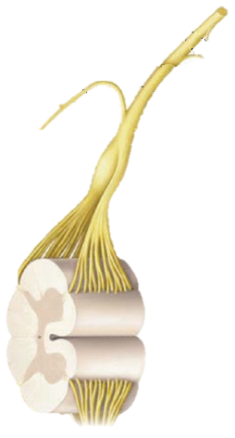
Making sense of Spinal Nerves
Rami means ‘branches’ →
← Spinal Nerve
=
← Roots
← (rootlets)
Notes:
Think about it like a tree, we have the roots which are like the dorsal and ventral root, we have the trunk, which is like the junction of the spinal roots or like the spinal nerves, then we have the branches. Rami in latin means branch.

Slide 33
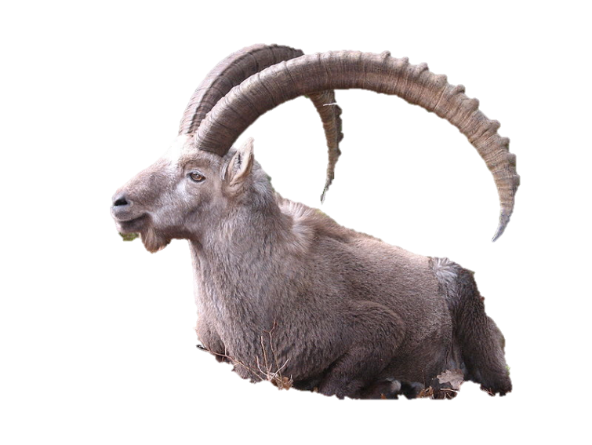
Making sense of Spinal Nerves
Rami means ‘branches’ →
← Spinal Nerve
← Roots
← (rootlets)
← Horns
Om nom..
Notes:
Think about it like a tree, we have the roots which are like the dorsal and ventral root, we have the trunk, which is like the junction of the spinal roots or like the spinal nerves, then we have the branches. Rami in latin means branch.

Slide 34
Group Activity: Neuronal Pathways
Get in a group of 3-4.
Grab a whiteboard and draw/write out all of the neuronal pathways
From fingertip to spinal cord to brain
From brain to spinal cord to back muscles
Your brain is receiving signals from your stomach, thus it tells your stomach to rumble.
Notes:
Go through activity. Make sure students get into groups of 3-4.

Slide 35
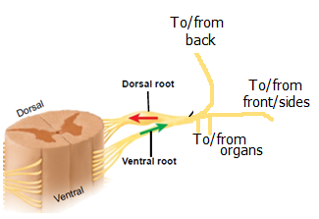
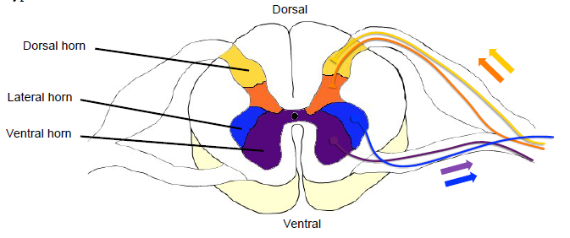
Still confused?
Rami
Split by signal start/end
Ventral: front/side of body
Dorsal: back of body
Communicating: organs (viscera)
Roots
Split by signal type
Dorsal: Sensory
Ventral: Motor
Horns: both!
Dorsal: SENSORY
Ventral + Lateral: MOTOR
Ventral: somatic
Lateral: visceral
Note: visceral signals are always sent to/from an area closer to the center of the spinal cord
Motor signal split b/w ventral and the more “central” lateral horn
Sensory all on dorsal horn

Slide 36
More Function

Slide 37
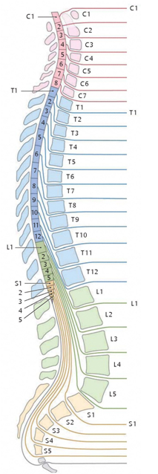
Segmentation of the Nervous System
Spinal segments
Vertebral levels
Spinal nerves
Each spinal nerve corresponds to a vertebra
Each segment has its own pair of spinal nerves
Note the portion of the spinal cord from which the spinal nerves originate is more superior than the vertebrae from which they exit
Superior
C8
Inferior
C8

Slide 38
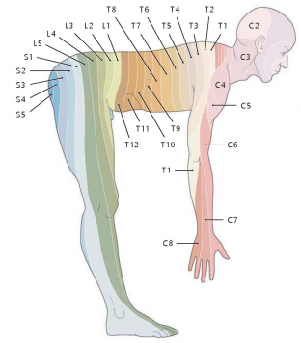
Segmentation of the Nervous System
The body’s pattern of innervation is segmental
Each segment is the width of a vertebra
Each segment is supplied by a pair of spinal nerves

Slide 39
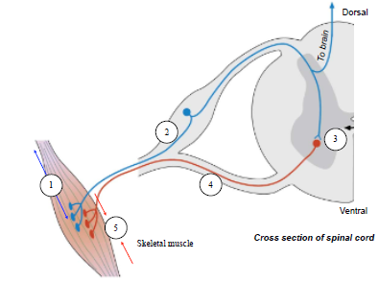
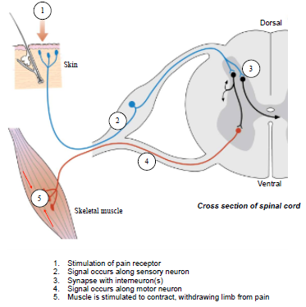
What is a reflex?
Definition: involuntary and stereotyped reactions
How does it work?
Not triggered by the brain
Simple wiring of the nervous system
Types of reflexes:
Monosynaptic/stretch
Polysynaptic/withdrawal
Monosynaptic = no interneuron
Polysynaptic = interneuron(s)
Still confused?? -- Watch these!
Monosynaptic:https://www.youtube.com/watch?v=t4N9qSKzlzw
Polysynaptic: https://www.youtube.com/watch?v=tP4cCMMSfX0
Courtesy of : Algonquin Academic

Slide 40
Case Study: Accident
You are an ER doctor
A person got this X-ray ->
L1 compression fracture causing severed spinal cord
From what dermatome level(s) will he not feel sensation?
Will he be able to do reflexes?
Notes:
Group up in 3-4 members and talk about this case. Here we see a compression fracture on the L1 vertebrae. What do you think this person will be able to feel and not be able to feel? Will he be able to express reflexes?

Slide 41
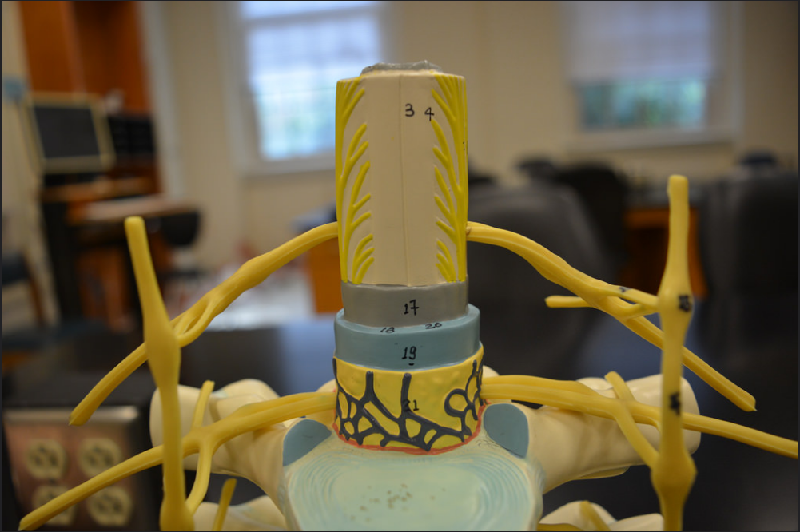
Things you can’t see on models: Lab 1
Dura mater, arachnoid mater, subarachnoid space
The blue on the spinal cord model is technically the combination of all 3 of these structures. You do NOT need to identify the BLUE structure.

Slide 42
Before you leave, make sure that you…
❑ Identify all of the bold terms in the lab manual on a model
❑ Explain the function of all anatomical structures
❑ Quiz your partner(s) on the structures and their functions

